Slide 1
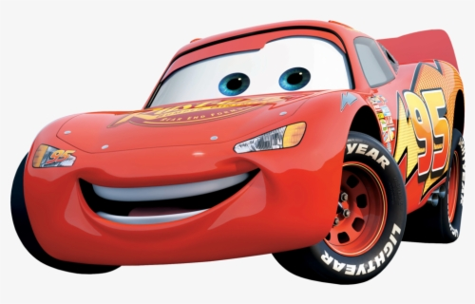
Car Classification
Group 3: Josh, Chris, and Tristan

Slide 2

Introduction and Assigned Classes
For the classes, Chris had Jeep, Josh had Kia, and Tristan had Volkswagen

Slide 3
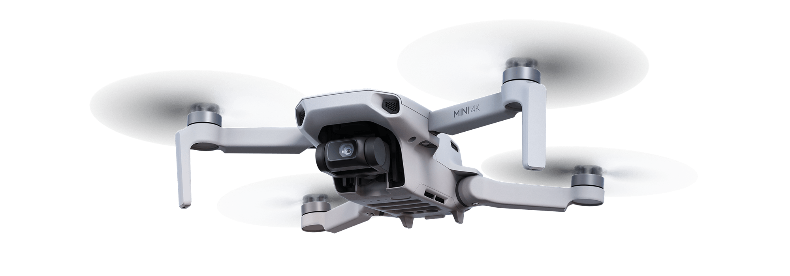
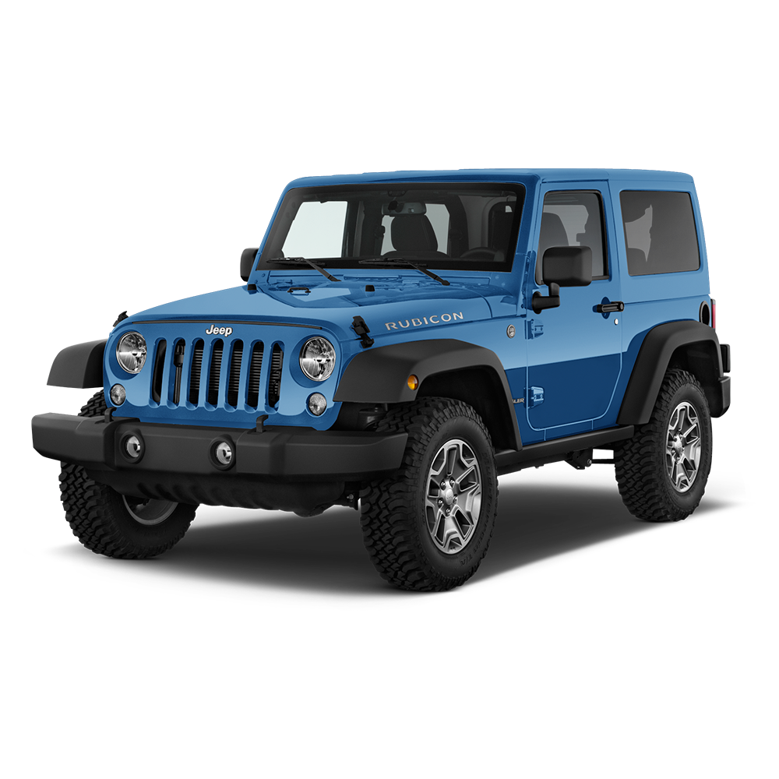
Data Collection & Samples
Training Set: 100 web scraped images per class
Validation Set: 20 images per class (drone pictures + web scraped)
Test Set: 2 images per class
(Taken with drone)

Slide 4
Training Results
Epochs: 30
Best Top-1 Accuracy: 0.5
Minimum Training Loss: 0.02348
Minimum Validation Result: 1.52688

Slide 5
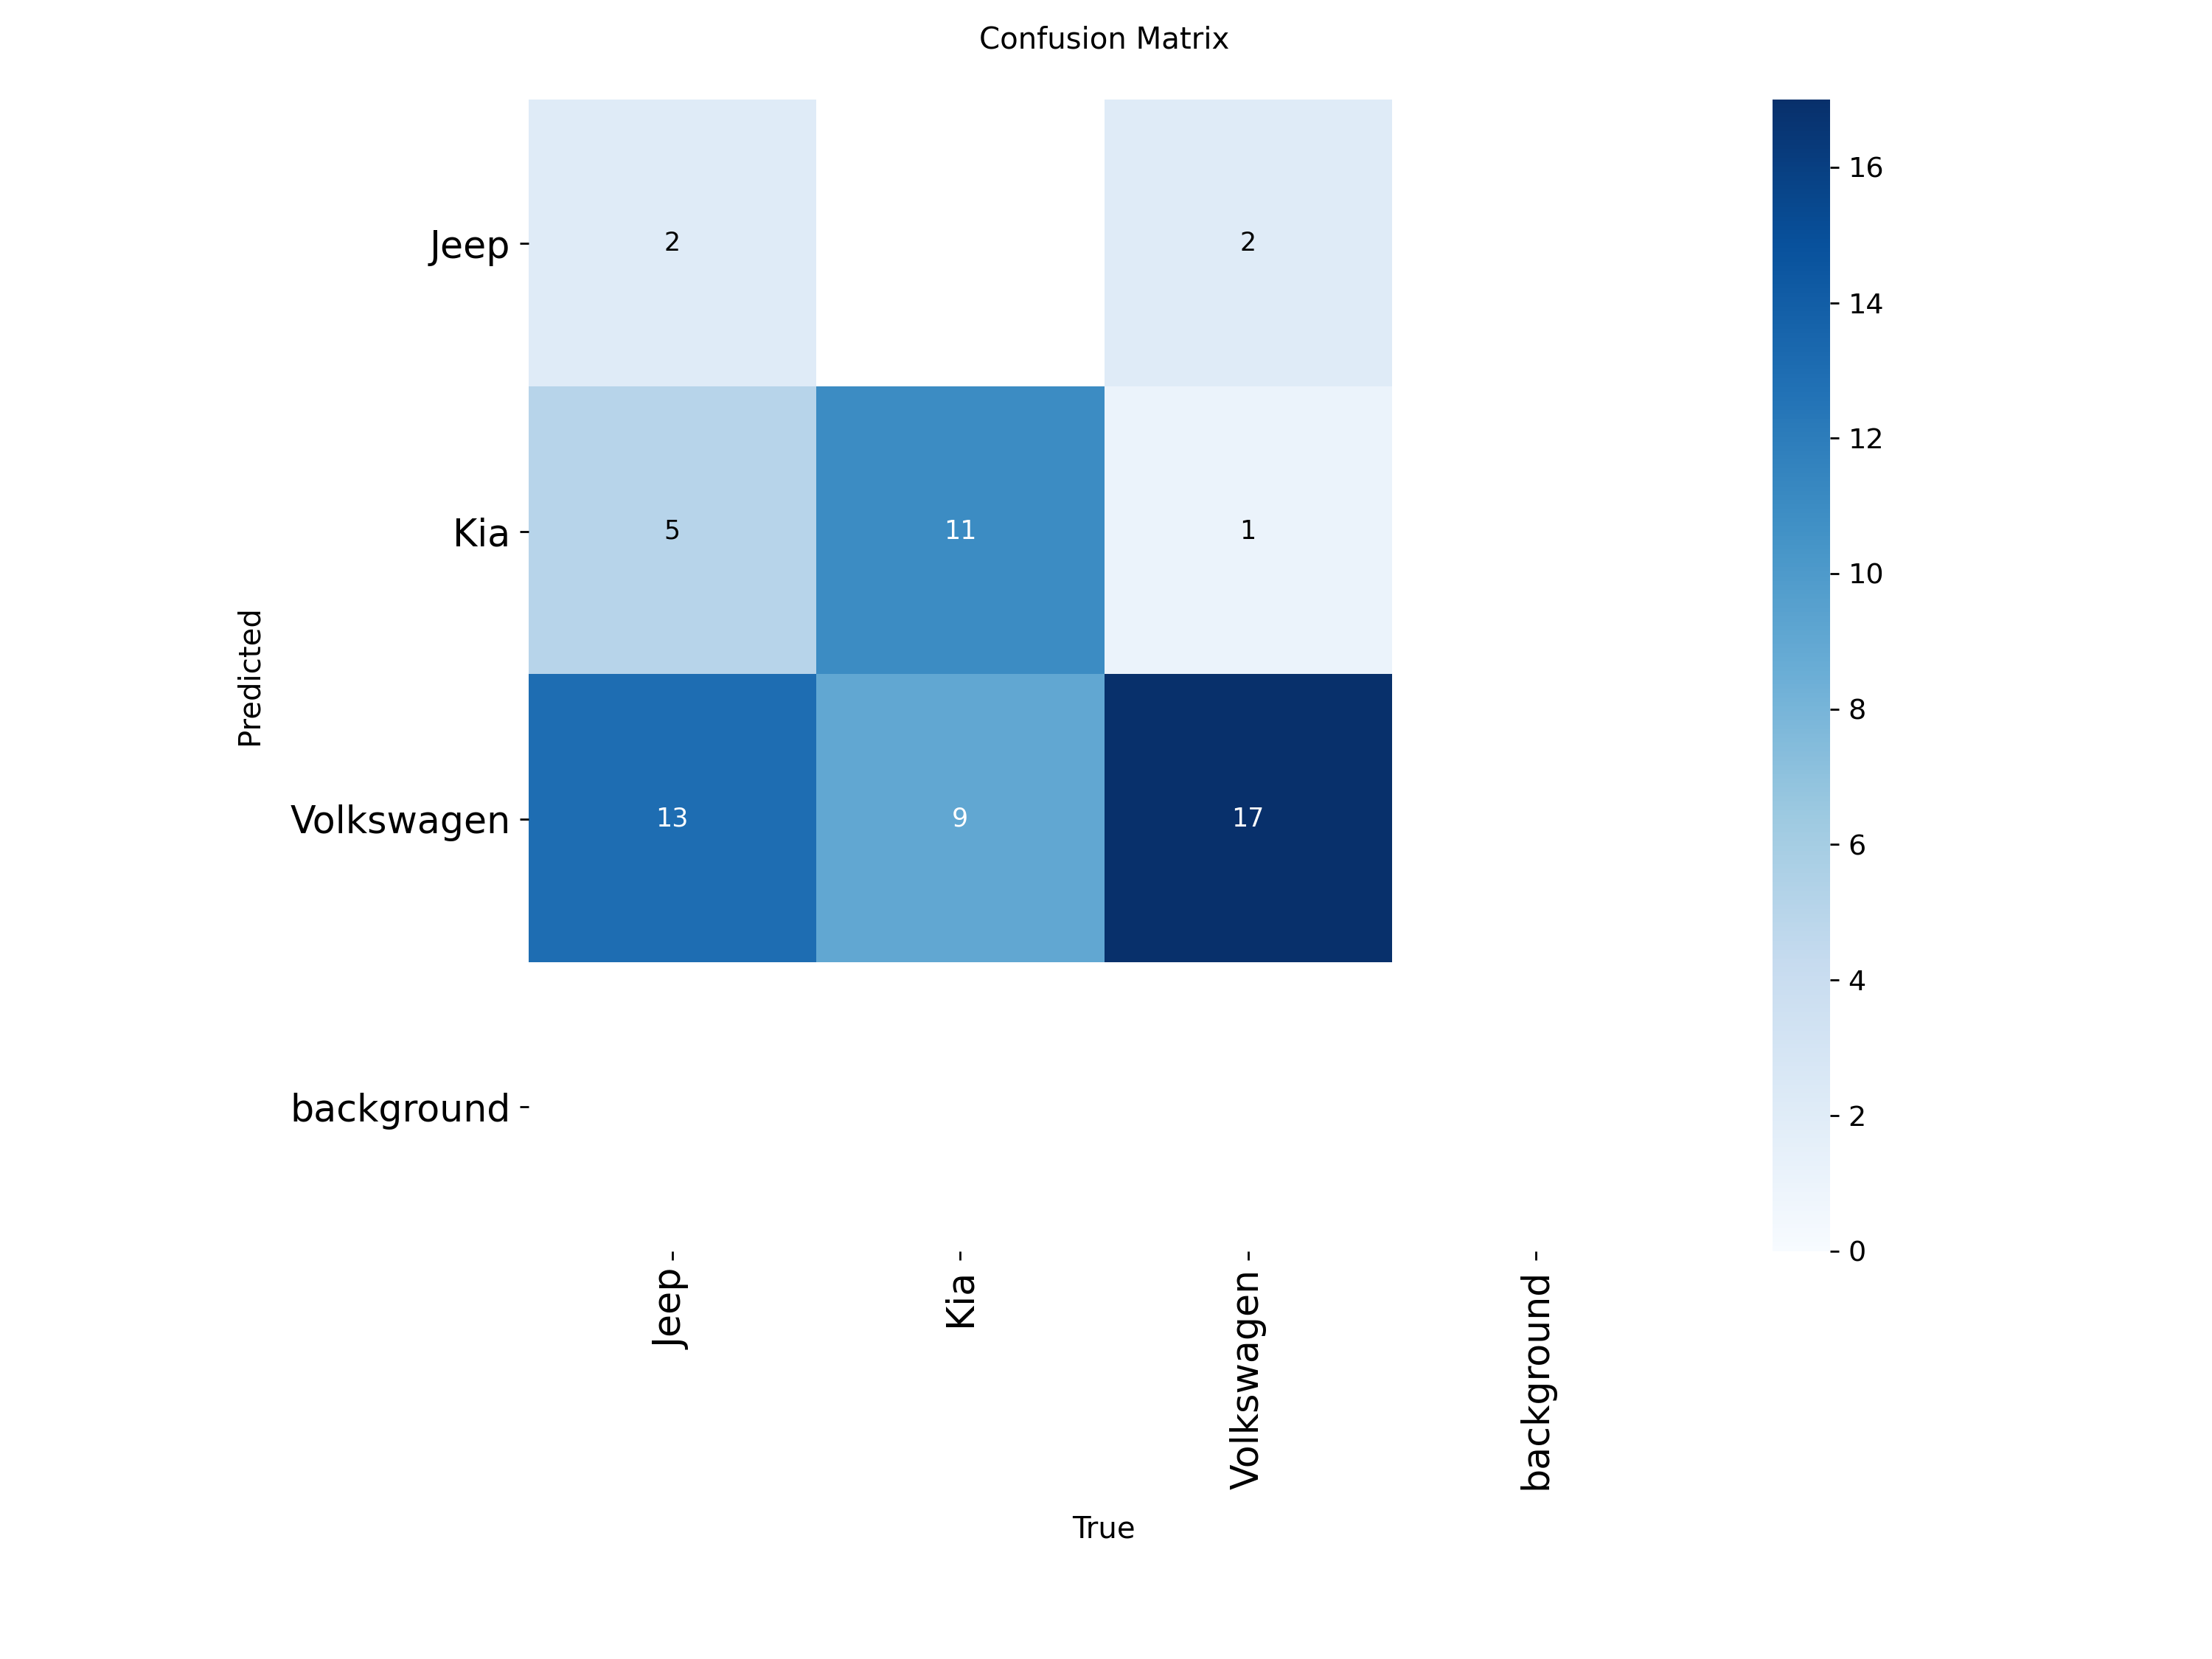
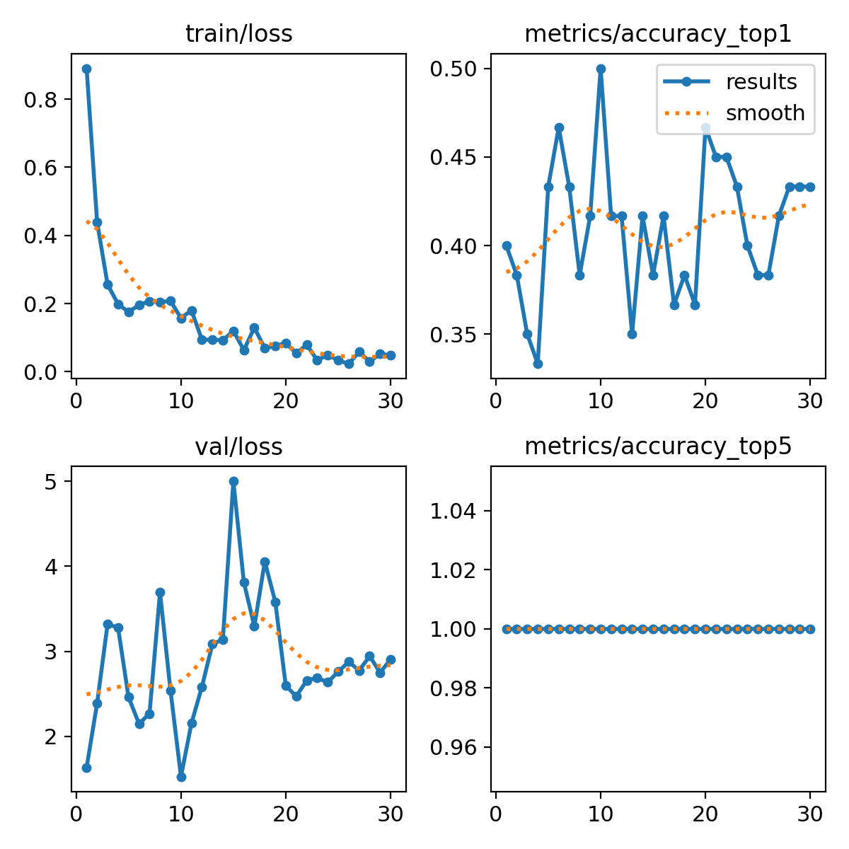
Test Results

Slide 6
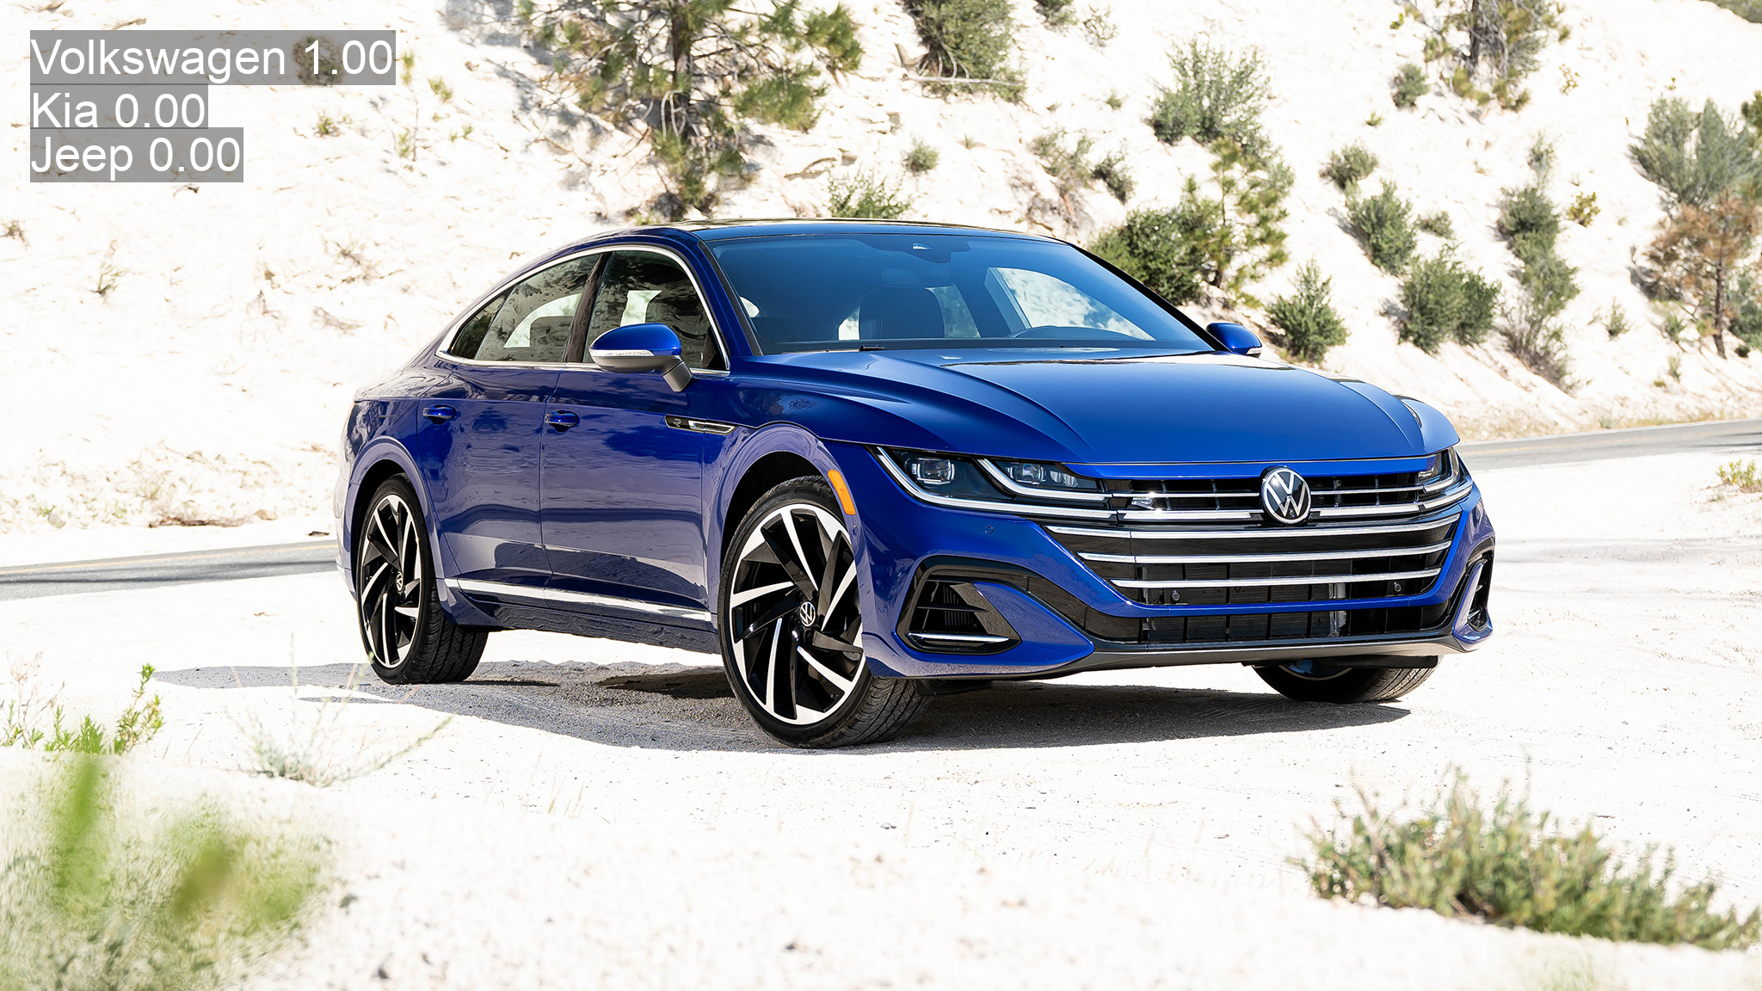

Slide 7
Conclusion
More epochs = higher accuracy?
Better drone angles = better results
Possibly a bigger dataset = higher accuracy
Maybe a different model (Model used: YOLOv11)

